Slide 1
Collegial Partnerships
ACTION RESEARCH PROJECT by Jeff Doruff
January 2025

Slide 2
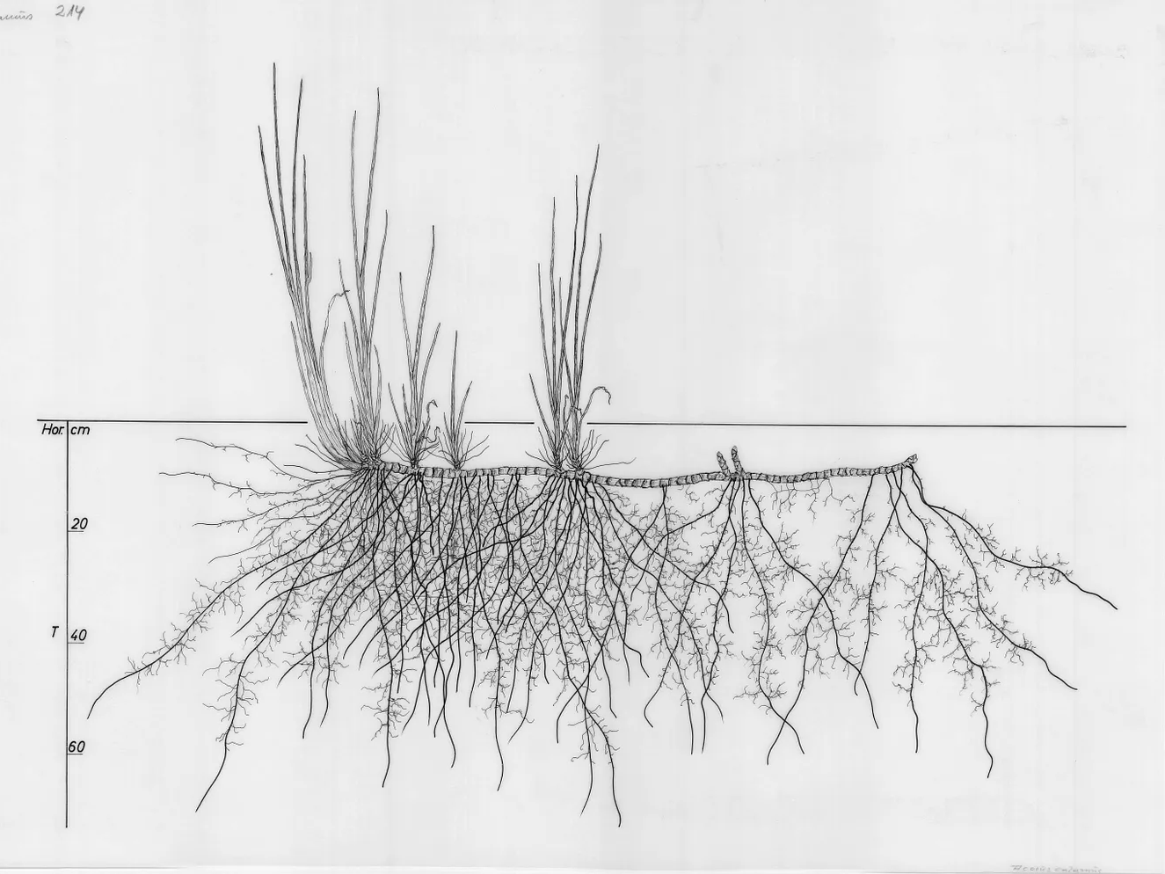
This action research project explores the conditions for supporting positive and sustainable collegial partnerships and collegial feedback.
Overview
2 / 26
Notes:
In reflexive qualitative analysis, the researcher is neither an inert actor nor is their subjectivity a methodological flaw to be partitioned away from the process. Rather, their positionality and interpretive lens is a necessary and essential resource that needs to be acknowledged and active in the process. Qualitative rigour is demonstrated through transparency, reflexivity and analytic responsibility rather than detachment (Braun and Clarke, 2021)

Slide 3

Background & Context
“We work like we’re an aeroplane. We’re like multiple jet engines on a wing and we're all facing in roughly the same direction […] It's not like we're working against one another per se, but we're working in parallel lines alongside one another… siloed.”
- ARP Participant Quote
Rationale for selecting the topic
3 / 26
Notes:
I’m a Stage Leader and Lecturer on BA Product and Industrial Design at CSM.
There was frustration. Tension between colleagues. Tired of the same kind of thing. Resentment. Feeling unrecognised.
It’s not
Had not experienced a culture of peer feedback between staff on the course and felt stuck in my professional development.
I was cognisant of existing and historical collegial tensions and other frustrations about the course due to my relation with the course.
Gap between institutional rhetoric and lived collegiality
As BERA (2024) note, “dual roles may also introduce explicit tensions in areas such as confidentiality”, particularly where researchers are reflecting on their own professional practice in relation to colleagues. Braun & Clarke (2021) similarly refer to this as being an “insider researcher”.
Despite this shift, I chose to maintain consistency in the interview questions across participants. This decision was both methodological and ethical, helping to avoid leading participants and strengthening the credibility of the thematic patterns, which emerged without being explicitly prompted.
Finally, I was torn over how much of myself to bring into interviews. Unlike previous research contexts, complete neutrality felt artificial. I occasionally shared my own experiences or reflections when they felt directly relevant, while remaining mindful of not steering participants’ accounts. In light of the scholarly positions, it is part of the ethical complexity of conducting research within one’s own professional community, which reflected the situated and relational nature of ethical practice described by Banks (2016).

Slide 4
“In the process of clarifying the meanings of your embodied values, as they emerge in practice, you transform your values into your criteria” (McNiff, 2002).
STARTING WITH VALUES
Sense of growth and professional development
Collaboration
Reciprocal learning
Shared leadership
Recognition
Rationale for selecting the topic
4 / 26
Notes:
ARP is values in practice
In reflexive qualitative analysis, the researcher is neither an inert actor nor is their subjectivity a methodological flaw to be partitioned away from the process. Rather, their positionality and interpretive lens is a necessary and essential resource that needs to be acknowledged and active in the process. Qualitative rigour is demonstrated through transparency, reflexivity and analytic responsibility rather than detachment (Braun and Clarke, 2021)

Slide 5
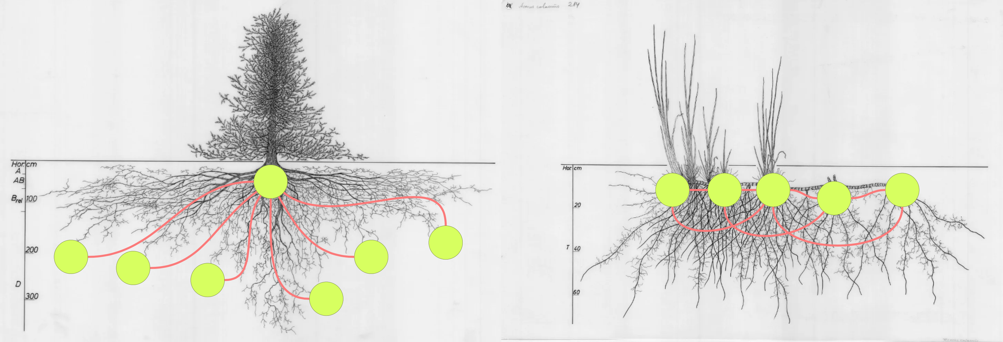
“I think it's kind of non-existent. […] maybe the level that [feedback] goes to (in PRCs) isn't that useful in terms of our collegial working and our collaboration
- ARP Participant Quote
Rationale for selecting the topic
5 / 26
Notes:
We are operating linearly. Like roots feeding into a tree, reproducing the same thing year after year.
Could also be a metaphor for line management, with 1 course leader line managing

Slide 6
How can we as colleagues support each other’s goals, learn reciprocally and share leadership?
Rationale for selecting the topic
6 / 26

Slide 7
Rationale for Research Methods
7 / 26
Notes:
How can we be like the rhizome and operate more relationally and distributed.
A rhizome is a horizontal, decentralized system: it can grow from any point and shoot off into separate rhizomes, meaning it’s not bound to a specific plant or tree.
Convenient metaphor.

Slide 8
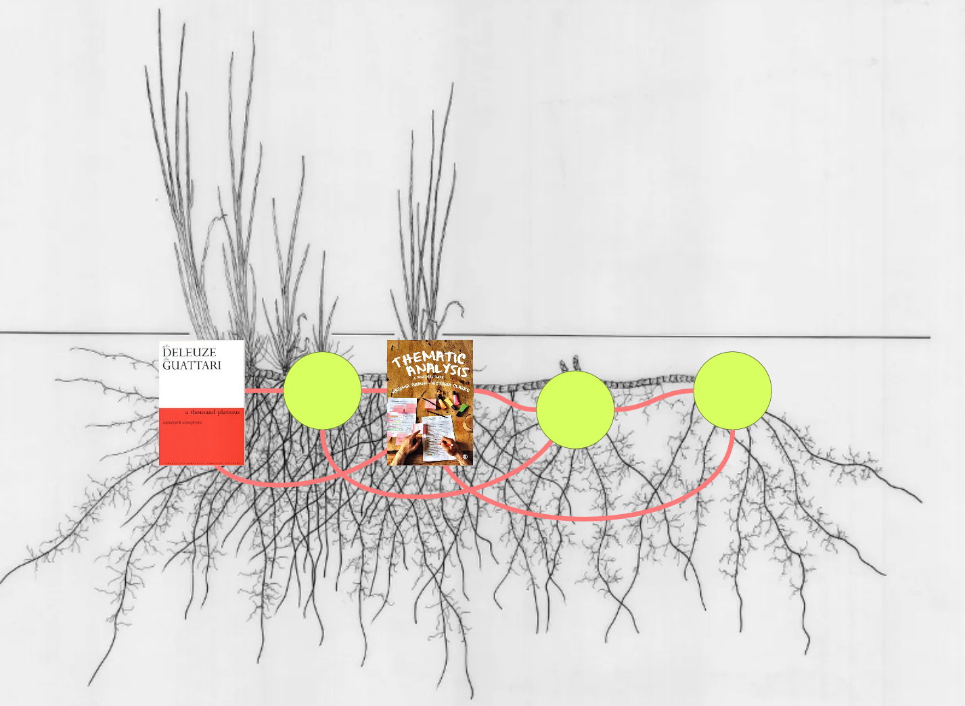
Interlude: A key theoretical framework
“A rhizome ceaselessly establishes connections between semiotic chains, organizations of power, and circumstances relative to the arts, sciences and social struggles” (Deleuze, 1987)
Rationale for Research Methods
8 / 26
Notes:
Rhizomatic theory resists the idea that knowledge is objective, stable and fully knowable from a single frame of reference. Instead, knowledge is relational, partial and always in the process of becoming.
This aligns with feminist and post-positivist critiques of objectivity, particularly Donna Haraway’s argument that all knowledge is “situated”, partial and produced from specific embodied positions rather than from a neutral or universal standpoint.
This shift helped me articulate why reflexive qualitative analysis.
Meaning are constructed through engagement with the data, shaped by our positionality, judgement and interpretive decisions (Braun & Clarke, 2022).

Slide 9
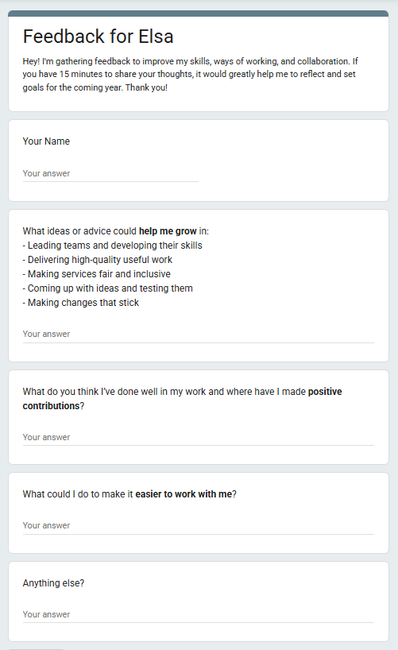
Inspiration: Camden Council’s Service Design Team’s Feedback Practices.
People write their own questions for feedback.
Allows them to ask for help in relation to PDGs.
Tied to skills framework.
Rationale for Research Methods
9 / 26

Slide 10

Benefits to staff and students
Psychological Safety
Professional Learning and Improved Practice
Collegial Feedback
Student Experience
“The advantages of quality teacher collaboration have been defended for a long time (e.g., Little, 1987). There is evidence of its effectiveness both for teacher professional development (e.g., Sun et al., 2013) and for student achievement” (Ribosa et al, 2024).
Context and Social Justice Framing
10 / 26

Slide 11
1. How to make feedback useful and support personal development goals?
Initial Research Questions
2. What would help staff feel comfortable giving and receiving peer-to-peer feedback?
Methodology: Rationale and Reflections
11 / 26

Slide 12


1. Self-authored collegial feedback questions will result in feedback that’s more relevant to one’s professional development goals and develop a culture of mutual support
Hypotheses
2. A feedback toolkit would be useful in helping people generate questions and feel more confident and supported when giving feedback.
Methodology: Rationale and Reflections
12 / 26

Slide 13
Assumption: Self-initiated collegial feedback requests will lead to feedback that’s more relevant to one’s professional development and develop a culture of mutual support.
Rationale for Research Methods
13 / 26

Slide 14
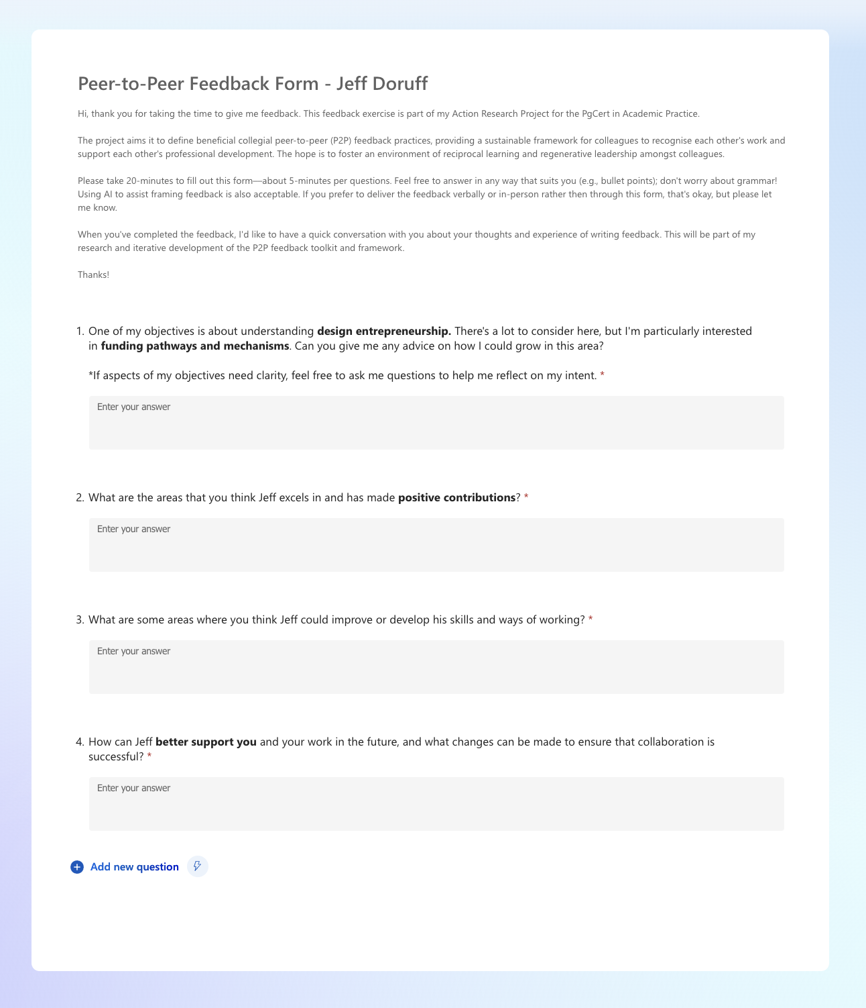
My own feedback form
Methodology: Rationale and Reflections
14 / 26

Slide 15

Participants in Peer Feedback Activity
🤔
5 of 13 FTE staff
0 of 4 HPL staff
The 5 participants were all in collaborative partnerships
Methodology: Rationale and Reflections
15 / 26

Slide 16
1. Peer-to-peer feedback experiences at UAL or externally. 2. Generating their own feedback questions. 3. Giving feedback
Semi-Structured Interviews
5 20-30 minutes interviews with participants who had participated in feedback activities
1 interview with UAL’s Organisational Development Team
1 playback session of early findings followed by group discussion with course colleagues
Methodology: Rationale and Reflections
2 / X
Notes:
Despite this shift, I chose to maintain consistency in the interview questions across participants. This decision was both methodological and ethical, helping to avoid leading participants and strengthening the credibility of the thematic patterns, which emerged without being explicitly prompted.
Finally, I was torn over how much of myself to bring into interviews. Unlike previous research contexts, complete neutrality felt artificial. I occasionally shared my own experiences or reflections when they felt directly relevant, while remaining mindful of not steering participants’ accounts. In light of the scholarly positions, it is part of the ethical complexity of conducting research within one’s own professional community, which reflected the situated and relational nature of ethical practice described by Banks (2016).

Slide 17


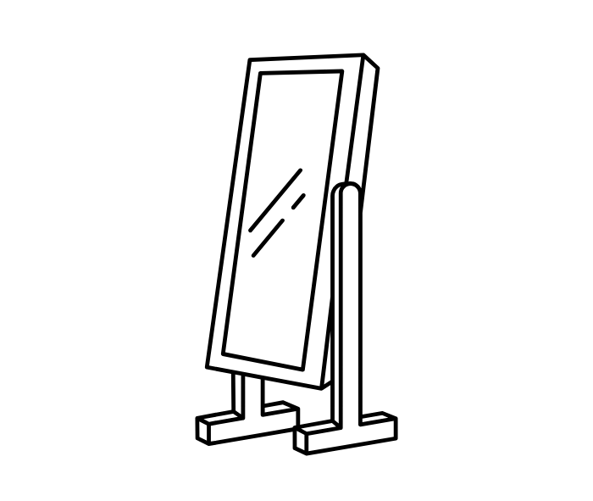
ETHICS & CONTEXTUAL CHALLENGES
“Dual roles may also introduce explicit tensions in areas such as confidentiality”
(British Educational Research Association, 2024)
_
“insider researcher”
(Braun & Clarke, 2021)
PARTICIPATION
REPRESENTATION
Methodology: Contextual Challenges
2 / X
Notes:
my primary ethical concern shifted from participation and towards analysis and representation.
As BERA (2024) note, “dual roles may also introduce explicit tensions in areas such as confidentiality”, particularly where researchers are reflecting on their own professional practice in relation to colleagues. Braun & Clarke (2021) similarly refer to this as being an “insider researcher”.

Slide 18
A NEW PRIMARY QUESTION: What conditions would support positive and sustainable collegial partnerships?
Methodology: Rationale and Reflections

Slide 19
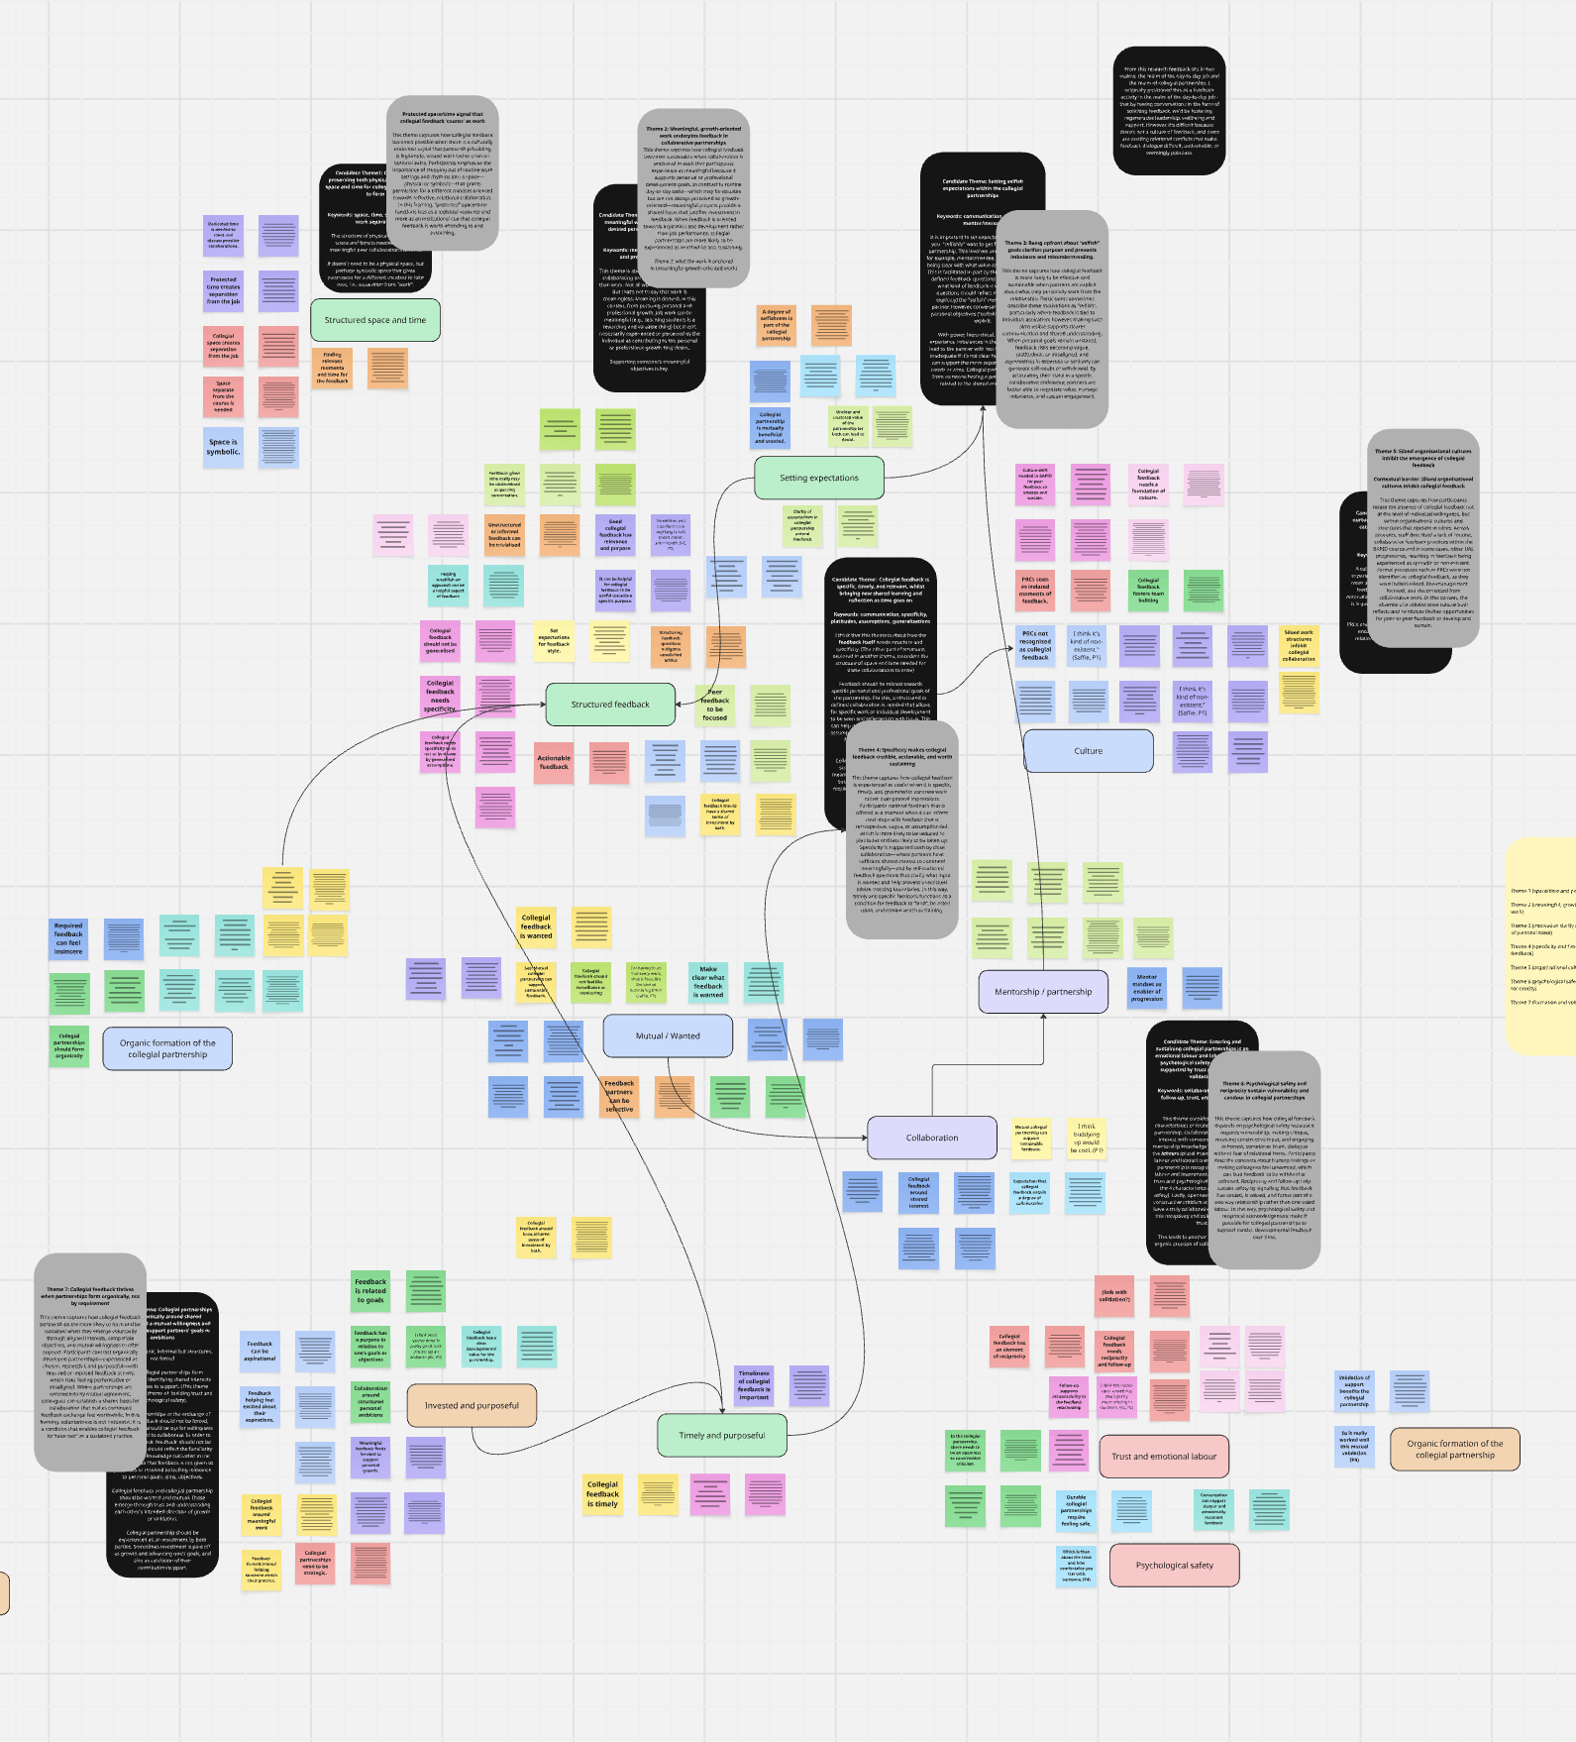
REFLEXIVE THEMATIC ANALYSIS
Methodology: Rationale and Reflections
19 / 26
Notes:
The analysis was conducted using reflexive thematic analysis with an inductive orientation, allowing patterns of meaning to be developed from participants’ accounts rather than fitted to pre-existing theory. The study adopted an experiential qualitative framework, treating participants’ talk as meaningful accounts of lived experience within a specific institutional context. Analysis attended to both semantic meaning, focusing on what participants explicitly articulated, and latent meaning, examining the assumptions, tensions, and conditions shaping how collegial feedback was understood and enacted. While a broadly uncomplicated relationship between language and experience was assumed, the analysis also recognised the researcher’s interpretive role in shaping theme development, and reflexivity was therefore maintained throughout coding and analysis.
What is challenging is creating a distinct focus for each theme but not the contextual complexity that's shared between the themes.
Sitting with these tensions reinforced the importance of resisting premature analytic closure and instead working carefully with complexity as it appeared, echoing Law’s argument that social research often sanitises mess in ways that obscure how phenomena actually operate (Law, 2004). As Braun and Clarke emphasise, qualitative rigour in reflexive thematic analysis lies not in analytic closure, but in transparent, well-justified interpretive decisions made in relation to context, purpose, and consequence (Braun and Clarke, 2021).

Slide 20
CONTEXTUAL THEME
Siloed organisational cultures inhibit the emergence of collegial feedback
Participants locate the absence of collegial feedback not at the level of individual willingness, but within organisational cultures and structures that operate in siloes.
Findings
20 / 26

Slide 21

CORE THEME 1
Protected space/time signal that collegial feedback ‘counts’ as work
Collegial feedback becomes possible when there is a culturally endorsed signal that partnership-building is legitimate, valued work.
Findings
21 / 26

Slide 22

CORE THEME 7
You Can’t Force Collegial Partnership
Collegial feedback partnerships are more likely to form and be sustained when they emerge voluntarily through aligned interests, compatible objectives and mutual willingness to offer support.
“For trust to exist, a kind of humus – a fertile ground – needs to be cultivated and nourished. And yet, there is also something spontaneous and organic in how trust grows. It cannot be engineered through policy language alone; it emerges through relational attentiveness, timing and genuine intent.”
- Written reflection from ARP Participant
Findings
22 / 26
Notes:
Participants contrast organically developed partnerships—experienced as chosen, respectful, and purposeful—with required or imposed feedback activity, which risks feeling performative or misaligned. Where partnerships are entered into by mutual agreement, colleagues can establish a shared basis for collaboration that makes continued feedback exchange feel worthwhile.

Slide 23

CORE THEME 2
Meaningful, growth-oriented work underpins feedback in collaborative partnerships
Collegial feedback becomes sustainable when collaboration is anchored in work that participants experience as meaningful because it supports personal or professional development goals.
Findings
23 / 26
Notes:
In contrast to routine day-to-day tasks—which may be valuable but are not always perceived as growth-oriented—meaningful projects provide a shared focus that justifies investment in feedback. When feedback is oriented towards aspiration and development rather than job performance, collegial partnerships are more likely to be experienced as worthwhile and sustaining.

Slide 24

CORE THEME 3
Let’s Be Honest About What We Want
Collegial feedback is more likely to be effective and sustainable when partners are explicit about what they personally want from the relationship.
*Being upfront about “selfish” goals clarifies purpose and prevents imbalance and misunderstanding.
”I really like [mentoring] and I can do it well. It's a mix of personal, almost selfish reasons to be able to know I was – in a tiny, tiny part – responsible for that person’s growth. I think it's incredible. It's a huge part of my satisfaction, way more than sitting in a committee.”
- ARP Participant
Findings
24 / 26
Notes:
Participants sometimes describe these motivations as “selfish”, particularly where feedback is tied to individual aspiration; however, making such aims visible supports clearer communication and shared understanding. When personal goals remain unstated, feedback risks becoming vague, platitudinal, or misaligned, and asymmetries in expertise or seniority can generate self-doubt or withdrawal. By articulating their stake in a specific collaborative endeavour, partners are better able to negotiate value, manage imbalance, and sustain engagement.

Slide 25

CORE THEME 4
Specific Enough to Be Useful
Collegial feedback is experienced as useful when it is specific, timely and grounded in concrete work rather than general impressions.
“Because of the organic nature, [they] had a closeness with a particular thread of my work and it felt like because it was focused on a particular thread rather than a generalisation, it allowed for a kind of usefulness in the feedback that wasn't general.”
- ARP Participant Interview Quote
Findings
25 / 26
Notes:
Participants contrast feedback that is offered at a moment when it can inform next steps with feedback that is retrospective, vague, or assumption-led, which is more likely to be reduced to platitudes and less likely to be taken up. Specificity is supported both by close collaboration – where partners have sufficient shared context to comment meaningfully – and by self-authored feedback questions that clarify what input is wanted and help prevent unsolicited advice crossing boundaries. In this way, timely and specific feedback functions as a condition for feedback to “land”, be acted upon, and remain worth sustaining.

Slide 26

CORE THEME 6
Safety Makes Candour Possible
Psychological safety and reciprocity sustain vulnerability and candour in collegial partnerships.
“The professional development here is really about working with the right line management to do the right thing at the right time, and getting a very rounded approach […] it’s a very safe method how we are working together.”
- ARP Participant Interview Quote
Findings
26 / 26
Notes:
Participants describe concerns about hurting feelings or making colleagues feel unwanted, which can lead feedback to be withheld or softened. Reciprocity and follow-up help sustain safety by signalling that feedback has landed, is valued, and forms part of a two-way relationship rather than one-sided labour. In this way, psychological safety and reciprocal acknowledgement make it possible for collegial partnerships to support candid, developmental feedback over time.

Slide 27
EVALUATION? “… Betti began offering informal mentoring, which will now evolve into a more formalised arrangement as a result of this process. […] This collegial feedback exercise opened up a valuable conversation about establishing clearer boundaries and expectations, helping ensure that Betti is recognised for the additional work she takes on in offering her knowledge and support. This process accelerated that acknowledgement and allowed it to be a shared, openly discussed point for improvement.”
Conclusion

Slide 28
THANK YOU

